Slide 1
MODULE 4

Slide 2
COMPUTATIONAL GRAPHS
A computational graph is a directed graph where the nodes correspond to operations or variables.
Variables can feed their value into operations, and operations can feed their output into other operations.
Computational graphs are a type of graph that can be used to represent mathematical expressions. This is similar to descriptive language in the case of deep learning models, providing a functional description of the required computation.
In general, the computational graph is a directed graph that is used for expressing and evaluating mathematical expressions.

Slide 3
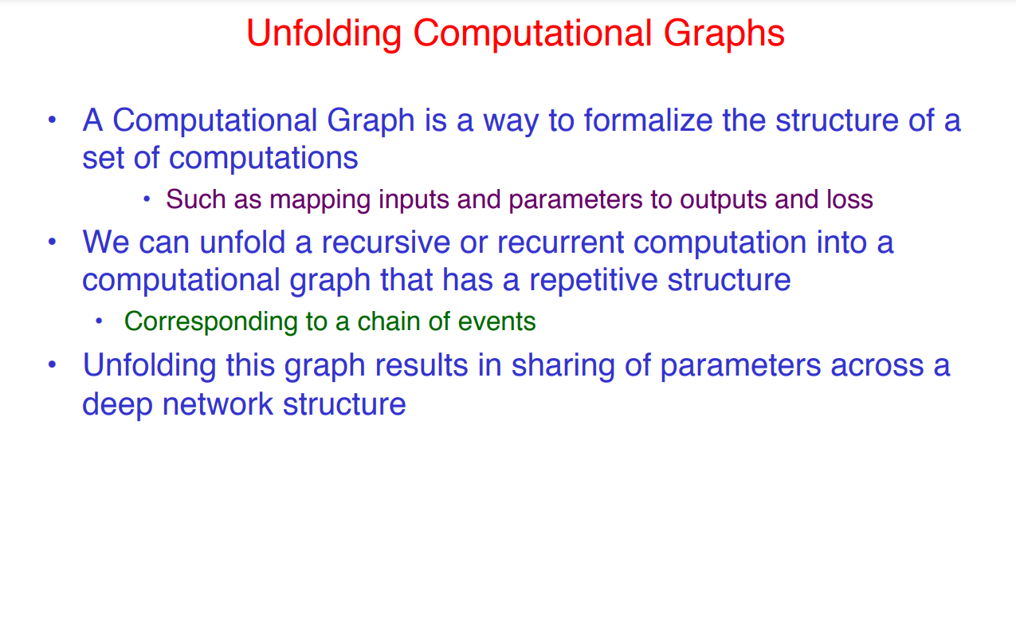
RECURRENT NEURAL NETWORK

Slide 4
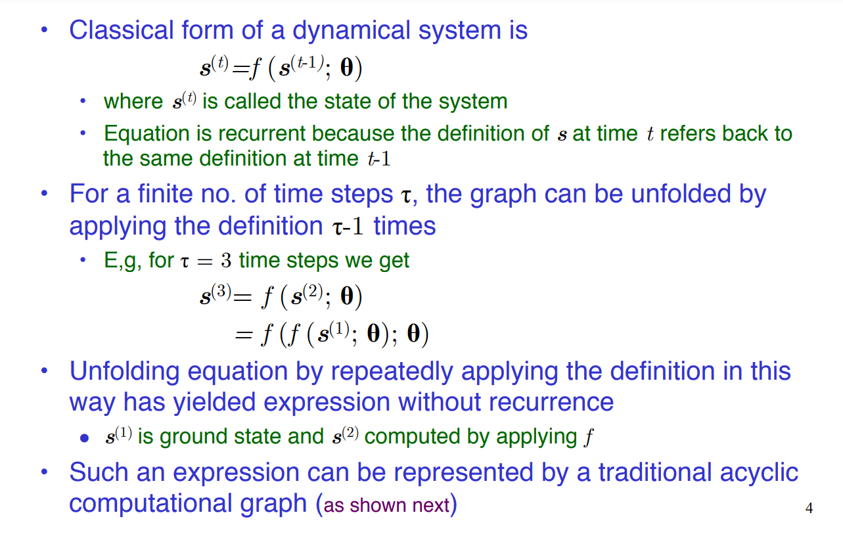

Slide 5
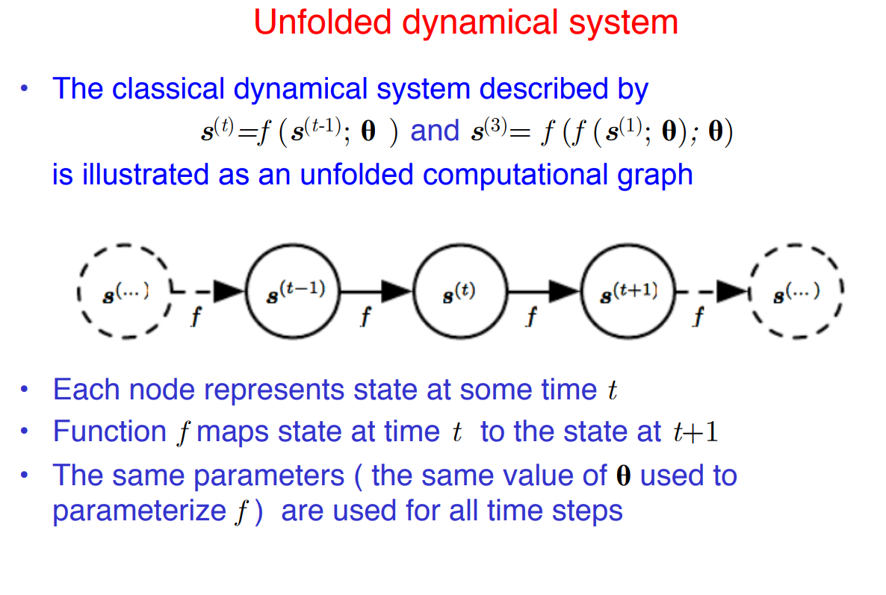

Slide 6
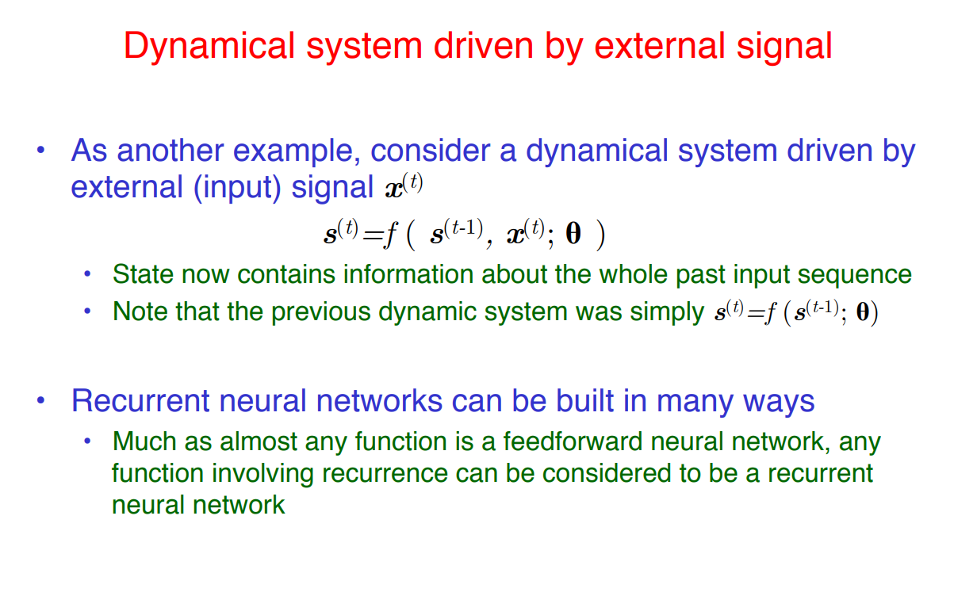

Slide 7
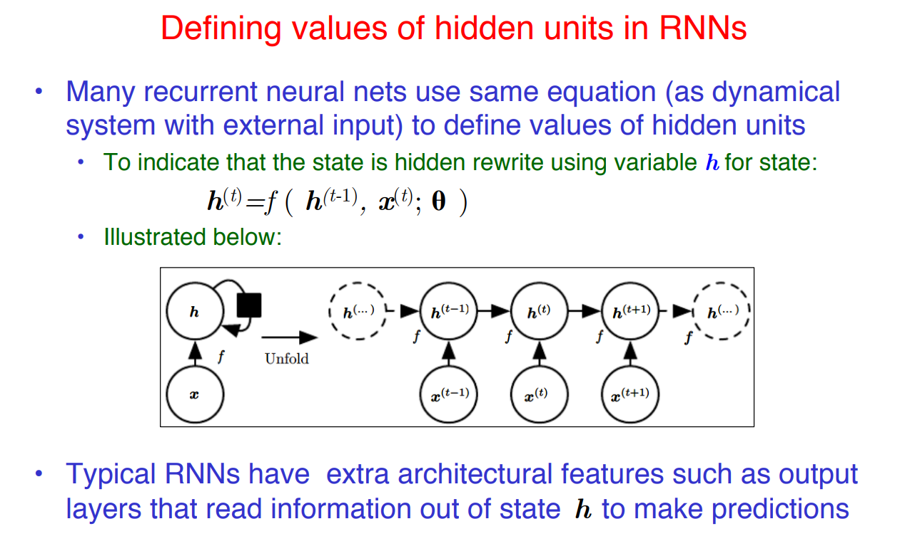

Slide 8
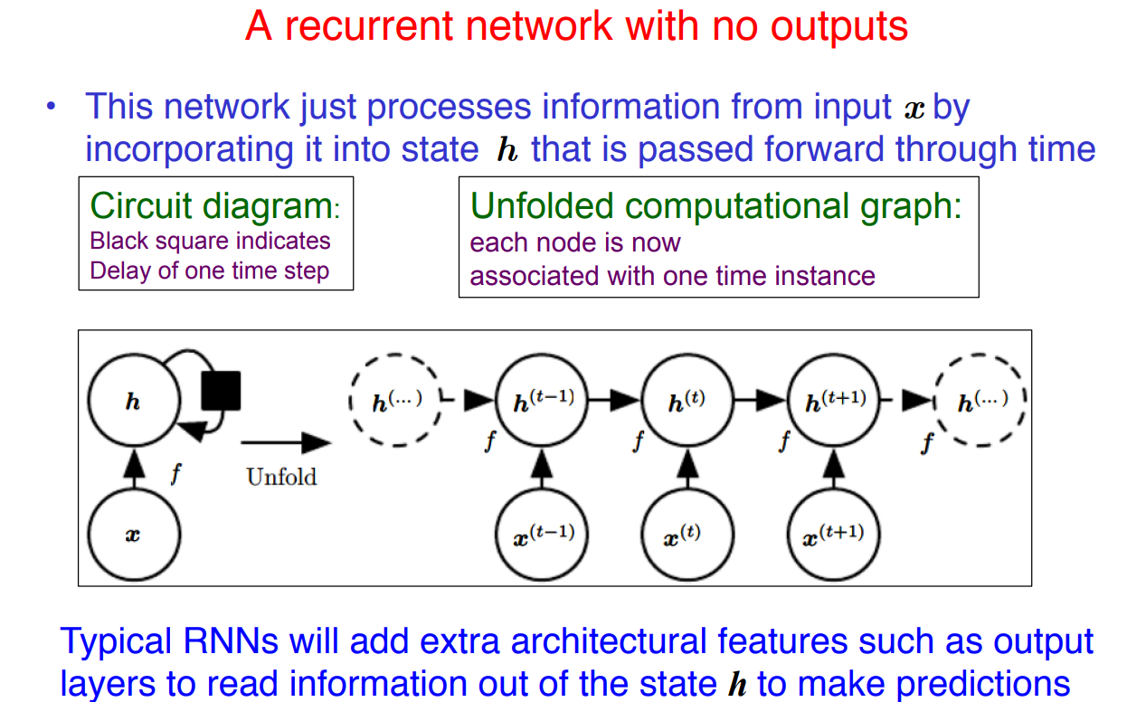

Slide 9
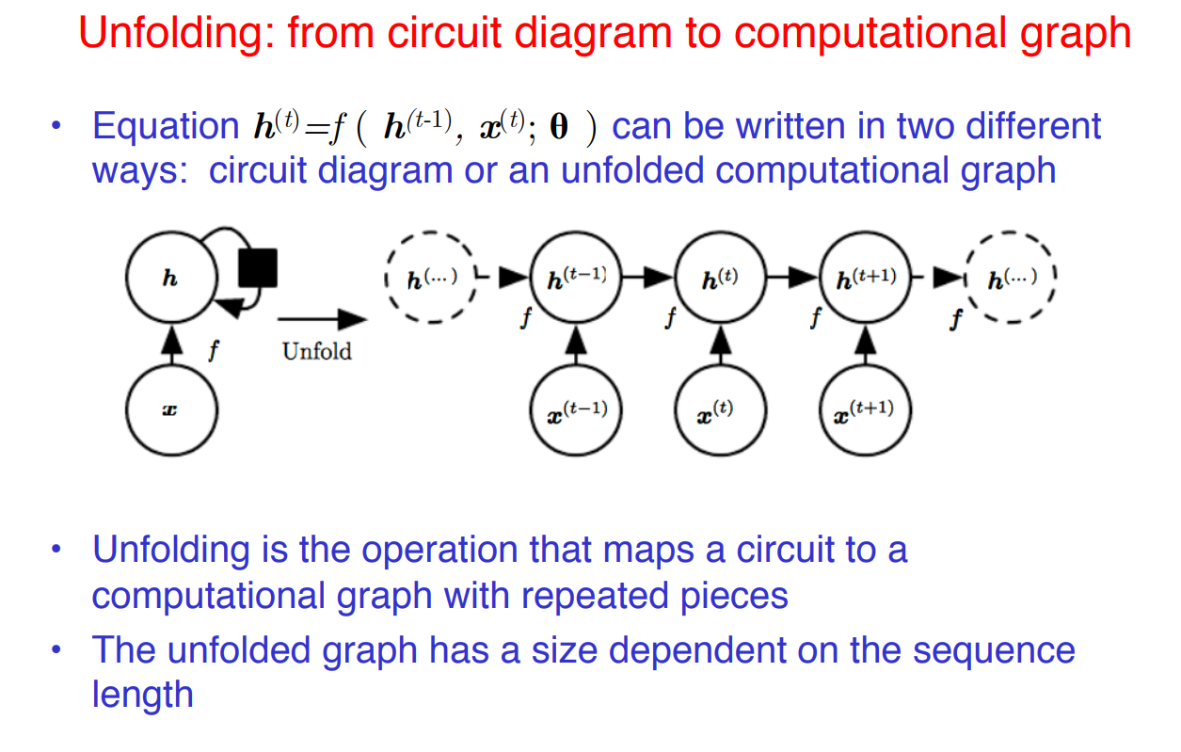

Slide 10
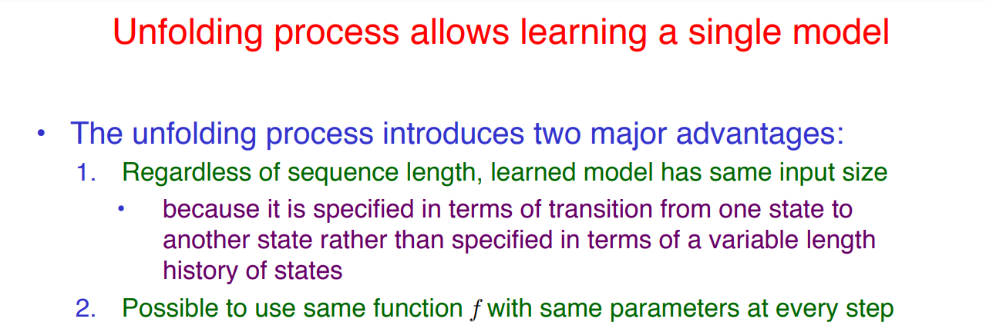

Slide 11
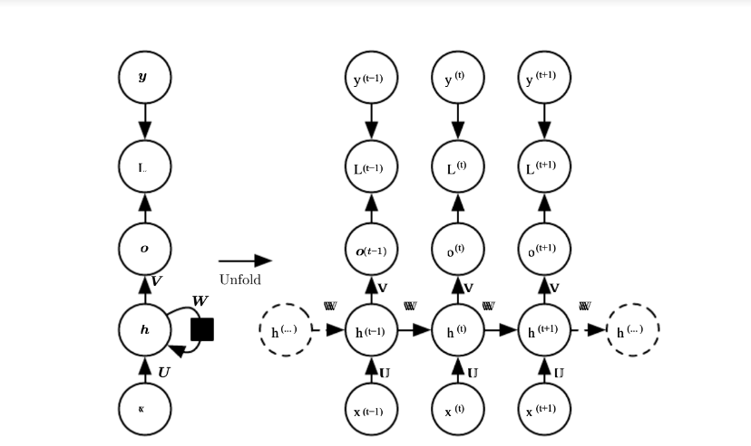

Slide 12
The computational graph to compute the training loss of a recurrent network that maps an input sequence of x values to a corresponding sequence of output o values.
A loss L measures how far each o is from the corresponding training target y.
When using softmax outputs, we assume o is the unnormalized log probabilities.
The loss L internally computes yˆ = softmax(o) and compares this to the target y.
The RNN has input to hidden connections parametrized by a weight matrix U , hidden-to-hidden recurrent connections parametrized by a weight matrix W, and hidden-to-output connections parametrized by a weight matrix V

Slide 13
RECURRENT NEURAL NETWORK
Recurrent Neural Network(RNN) is a type of Neural Network where the output from the previous step is fed as input to the current step.
In traditional neural networks, all the inputs and outputs are independent of each other, but in cases when it is required to predict the next word of a sentence, the previous words are required and hence there is a need to remember the previous words.
Thus RNN came into existence, which solved this issue with the help of a Hidden Layer.
The main and most important feature of RNN is its Hidden state, which remembers some information about a sequence.
The state is also referred to as Memory State since it remembers the previous input to the network.
It uses the same parameters for each input as it performs the same task on all the inputs or hidden layers to produce the output. This reduces the complexity of parameters, unlike other neural networks.

Slide 14
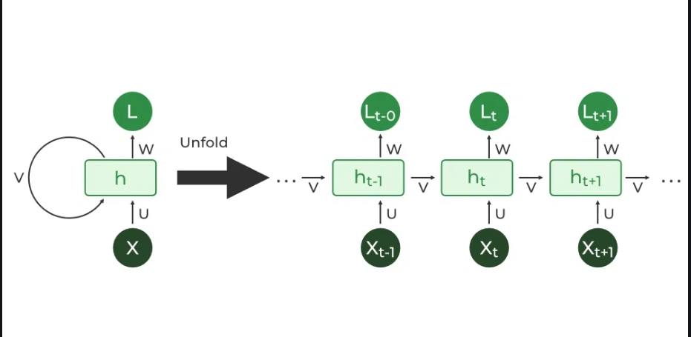

Slide 15

The Recurrent Neural Network consists of multiple fixed activation function units, one for each time step.
Each unit has an internal state which is called the hidden state of the unit.
This hidden state signifies the past knowledge that the network currently holds at a given time step.
This hidden state is updated at every time step to signify the change in the knowledge of the network about the past.
The hidden state is updated using the following recurrence relation:-
The formula for calculating the current state:

Slide 16
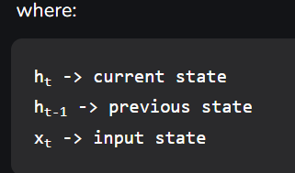
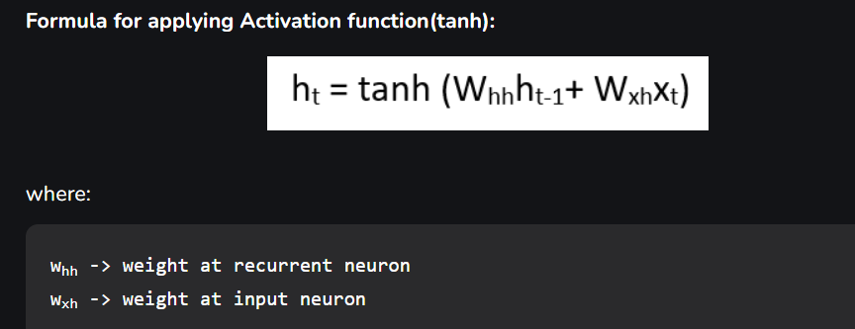

Slide 17
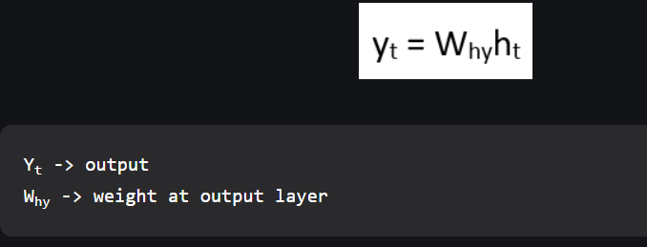

Slide 18
Training through RNN
A single-time step of the input is provided to the network.
Then calculate its current state using a set of current input and the previous state.
The current ht becomes ht-1 for the next time step.
One can go as many time steps according to the problem and join the information from all the previous states.
Once all the time steps are completed the final current state is used to calculate the output.
The output is then compared to the actual output i.e the target output and the error is generated.
The error is then back-propagated to the network to update the weights and hence the network (RNN) is trained using Backpropagation through time.

Slide 19
Advantages of Recurrent Neural Network
An RNN remembers each and every piece of information through time. It is useful in time series prediction only because of the feature to remember previous inputs as well. This is called Long Short Term Memory.
Recurrent neural networks are even used with convolutional layers to extend the effective pixel neighborhood.
Disadvantages of Recurrent Neural Network
Gradient vanishing and exploding problems.
Training an RNN is a very difficult task.
It cannot process very long sequences if using tanh or relu as an activation function.

Slide 20
Applications of Recurrent Neural Network
Language Modelling and Generating Text
Speech Recognition
Machine Translation
Image Recognition, Face detection
Time series Forecasting

Slide 21
Types Of RNN
There are four types of RNNs based on the number of inputs and outputs in the network.
One to One
One to Many
Many to One
Many to Many

Slide 22
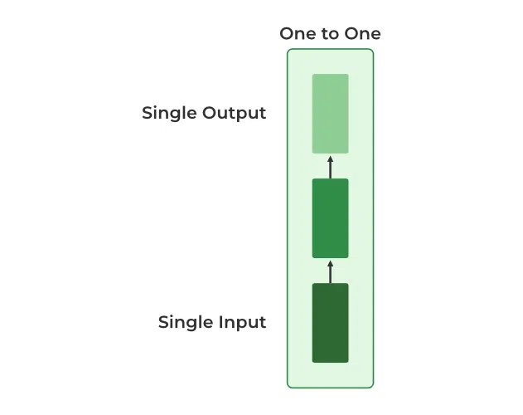
One to One
This type of RNN behaves the same as any simple Neural network it is also known as Vanilla Neural Network. In this Neural network, there is only one input and one output.

Slide 23
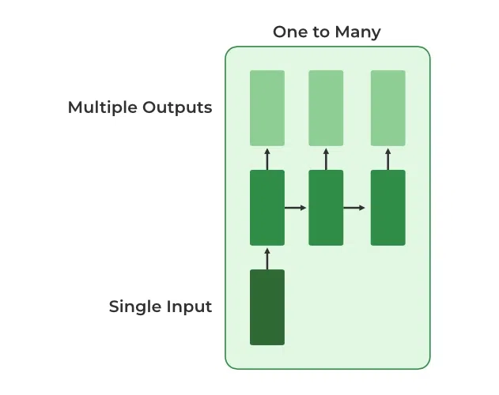
One To Many
In this type of RNN, there is one input and many outputs associated with it. One of the most used examples of this network is Image captioning where given an image we predict a sentence having Multiple words.
of Recurrent Neural Network
Language Modelling and Generating Text
Speech Recognition
Machine Translation
Image Recognition, Face detection
Time series Forecasting

Slide 24
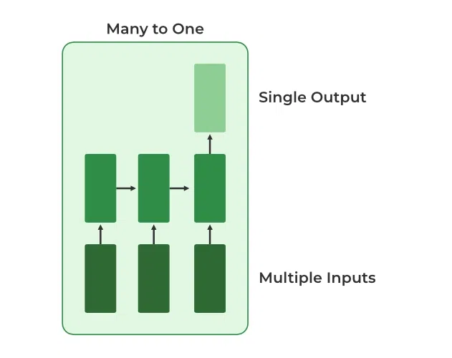
Many to One
In this type of network, Many inputs are fed to the network at several states of the network generating only one output. This type of network is used in the problems like sentimental analysis. Where we give multiple words as input and predict only the sentiment of the sentence as output.

Slide 25
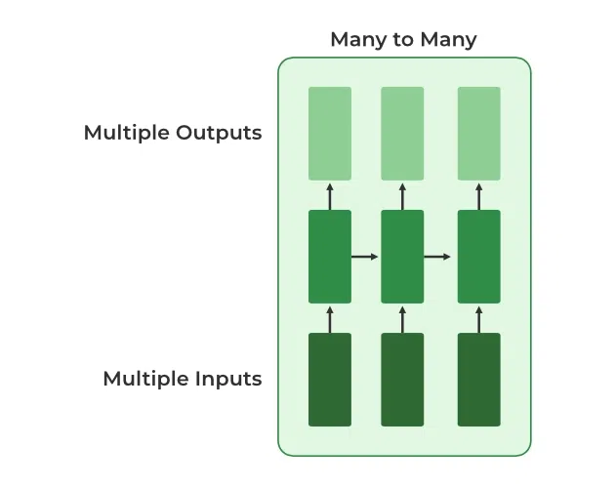
Many to Many
In this type of neural network, there are multiple inputs and multiple outputs corresponding to a problem. One Example of this Problem will be language translation. In language translation, we provide multiple words from one language as input and predict multiple words from the second language as output.

Slide 26
Variation Of Recurrent Neural Network (RNN)
To overcome the problems like vanishing gradient and exploding gradient descent several new advanced versions of RNNs are formed some of these are as ;
Bidirectional Neural Network (BiNN)
Long Short-Term Memory (LSTM)

Slide 27
Bidirectional Neural Network (BiNN)
A BiNN is a variation of a Recurrent Neural Network in which the input information flows in both direction and then the output of both direction are combined to produce the input. BiNN is useful in situations when the context of the input is more important such as Nlp tasks and Time-series analysis problems.

Slide 28
Long Short-Term Memory (LSTM)
Long Short-Term Memory works on the read-write-and-forget principle where given the input information network reads and writes the most useful information from the data and it forgets about the information which is not important in predicting the output. For doing this three new gates are introduced in the RNN. In this way, only the selected information is passed through the network.

Slide 29
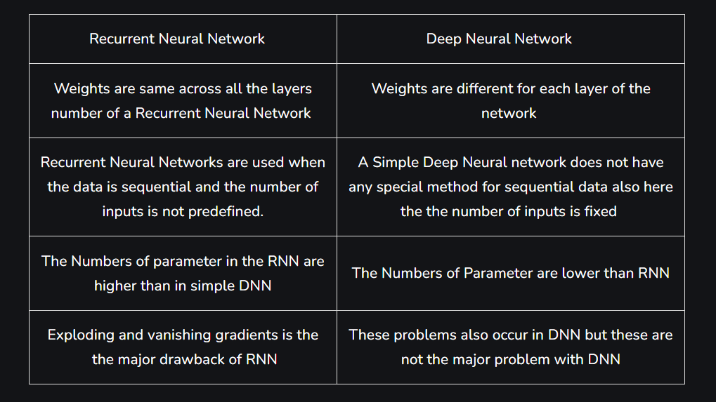
Difference between RNN and DNN

Slide 30
Encoder-Decoder Sequence to Sequence Architecture
In Deep Learning, Many Complex problems can be solved by constructing better neural network architecture.
The RNN(Recurrent Neural Network) and its variants are much useful in sequence to sequence learning.
The RNN variant LSTM (Long Short-term Memory) is the most used cell in seq-seq learning tasks.

Slide 31
Encoder-Decoder Model
There are three main blocks in the encoder-decoder model,
Encoder
Hidden Vector
Decoder
The Encoder will convert the input sequence into a single-dimensional vector (hidden vector). The decoder will convert the hidden vector into the output sequence.

Slide 32
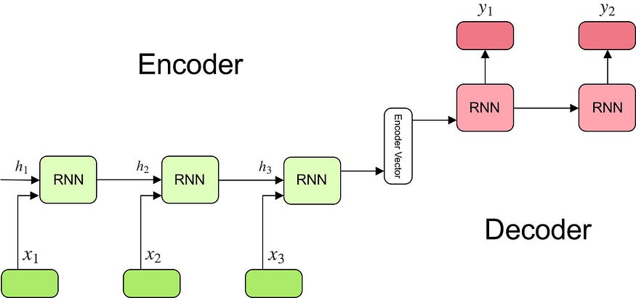

Slide 33
Encoder
Multiple RNN cells can be stacked together to form the encoder. RNN reads each inputs sequentially
For every timestep (each input) t, the hidden state (hidden vector) h is updated according to the input at that timestep X[i].
After all the inputs are read by encoder model, the final hidden state of the model represents the context/summary of the whole input sequence.
Example: Consider the input sequence “I am a Student” to be encoded. There will be totally 4 timesteps ( 4 tokens) for the Encoder model. At each time step, the hidden state h will be updated using the previous hidden state and the current input.

Slide 34
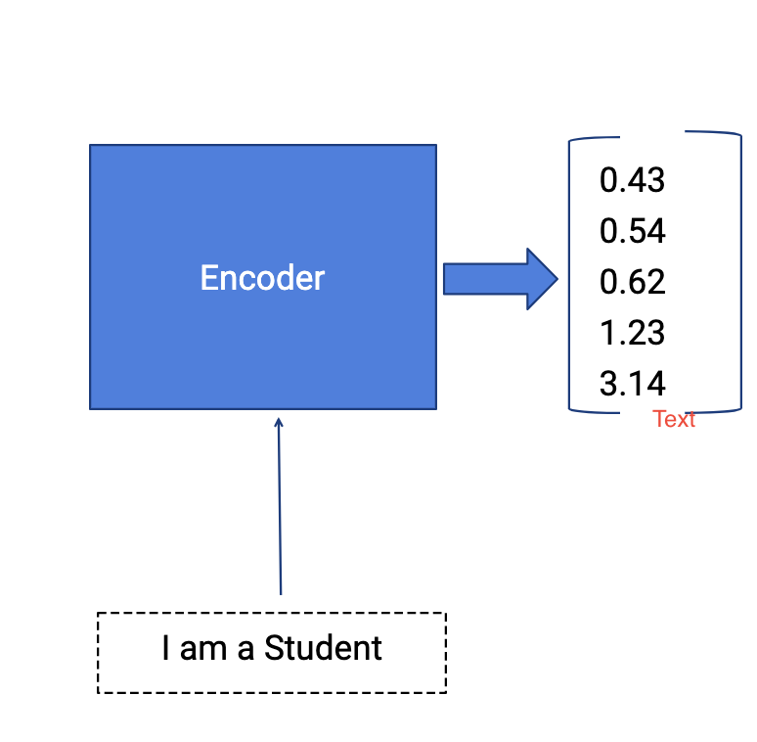

Slide 35
At the first timestep t1, the previous hidden state h0 will be considered as zero or randomly chosen.
So the first RNN cell will update the current hidden state with the first input and h0.
Each layer outputs two things — updated hidden state and the output for each stage.
The outputs at each stage are rejected and only the hidden states will be propagated to the next layer.

Slide 36
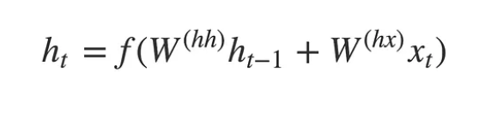
The hidden states h_i are computed using the formula:

Slide 37
At second timestep t2, the hidden state h1 and the second input X[2] will be given as input , and the hidden state h2 will be updated according to both inputs. Then the hidden state h1 will be updated with the new input and will produce the hidden state h2. This happens for all the four stages wrt example taken.
A stack of several recurrent units (LSTM or GRU cells for better performance) where each accepts a single element of the input sequence, collects information for that element, and propagates it forward.

Slide 38
Encoder Vector
This is the final hidden state produced from the encoder part of the model. It is calculated using the formula above.
This vector aims to encapsulate the information for all input elements in order to help the decoder make accurate predictions.
It acts as the initial hidden state of the decoder part of the model.

Slide 39
Decoder
The Decoder generates the output sequence by predicting the next output Yt given the hidden state ht.
The input for the decoder is the final hidden vector obtained at the end of encoder model.
Each layer will have three inputs, hidden vector from previous layer ht-1 and the previous layer output yt-1, original hidden vector h.
At the first layer, the output vector of encoder and the random symbol START, empty hidden state ht-1 will be given as input, the outputs obtained will be y1 and updated hidden state h1 (the information of the output will be subtracted from the hidden vector).

Slide 40
The second layer will have the updated hidden state h1 and the previous output y1 and original hidden vector h as current inputs, produces the hidden vector h2 and output y2.
The outputs occurred at each timestep of decoder is the actual output. The model will predict the output until the END symbol occurs.

Slide 41
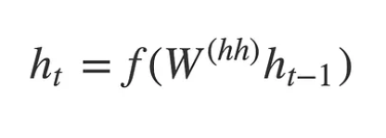
Any hidden state h_i is computed using the formula:

Slide 42
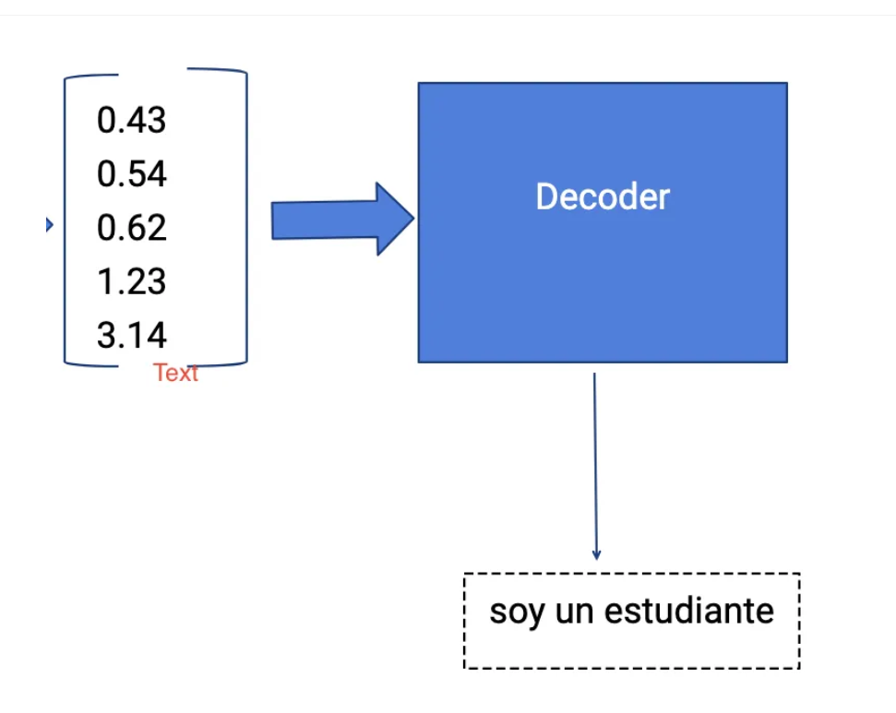

Slide 43
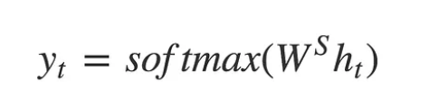
Output Layer
We use Softmax activation function at the output layer.
It is used to produce the probability distribution from a vector of values with the target class of high probability.
The output y_t at time step t is computed using the formula:

Slide 44
We calculate the outputs using the hidden state at the current time step together with the respective weight W(S).
Softmax is used to create a probability vector that will help us determine the final output

Slide 45
Applications
It possesses many applications such as
Google’s Machine Translation
Question answering chatbots
Speech recognition
Time Series Application etc.,

Slide 46
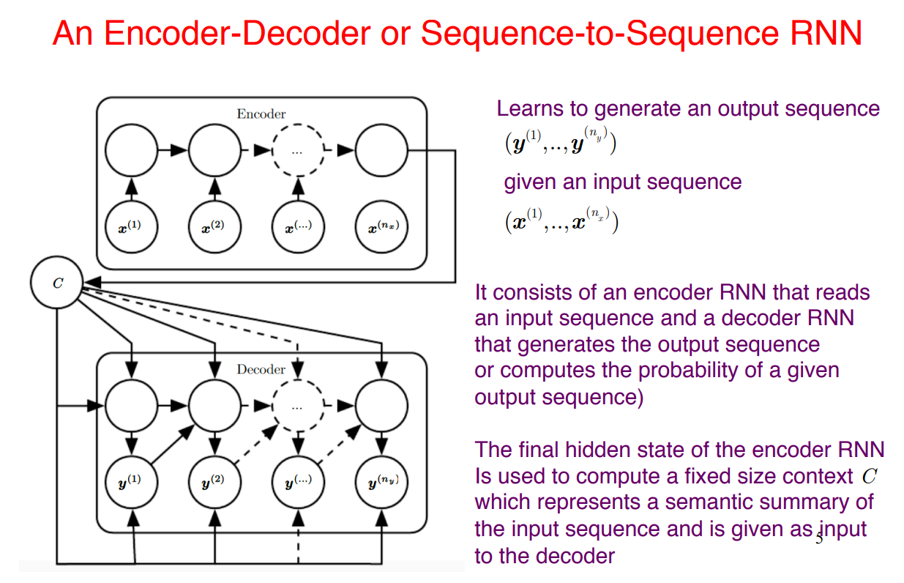

Slide 47
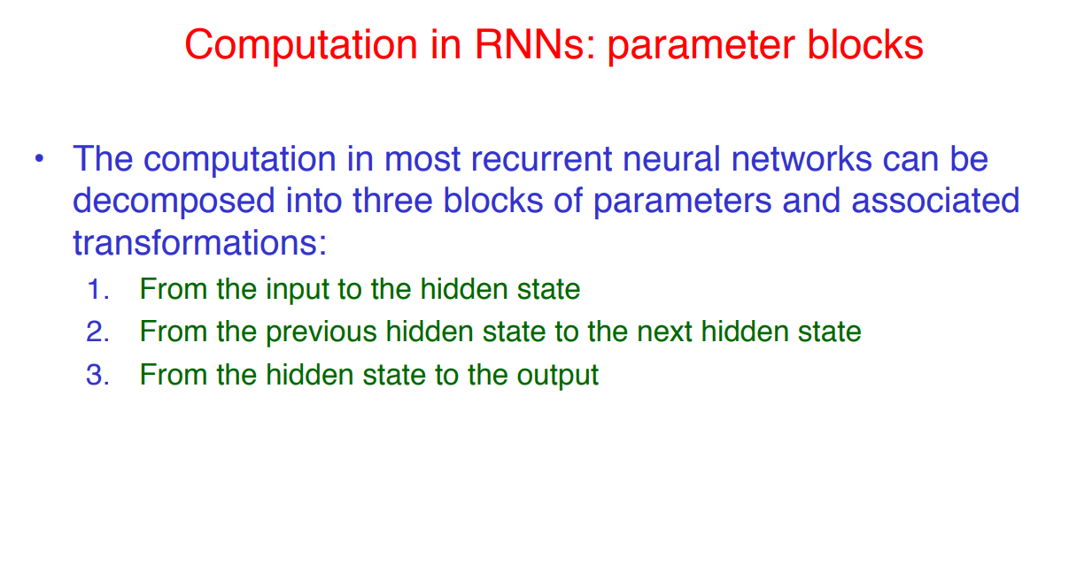
Deep Recurrent Network

Slide 48
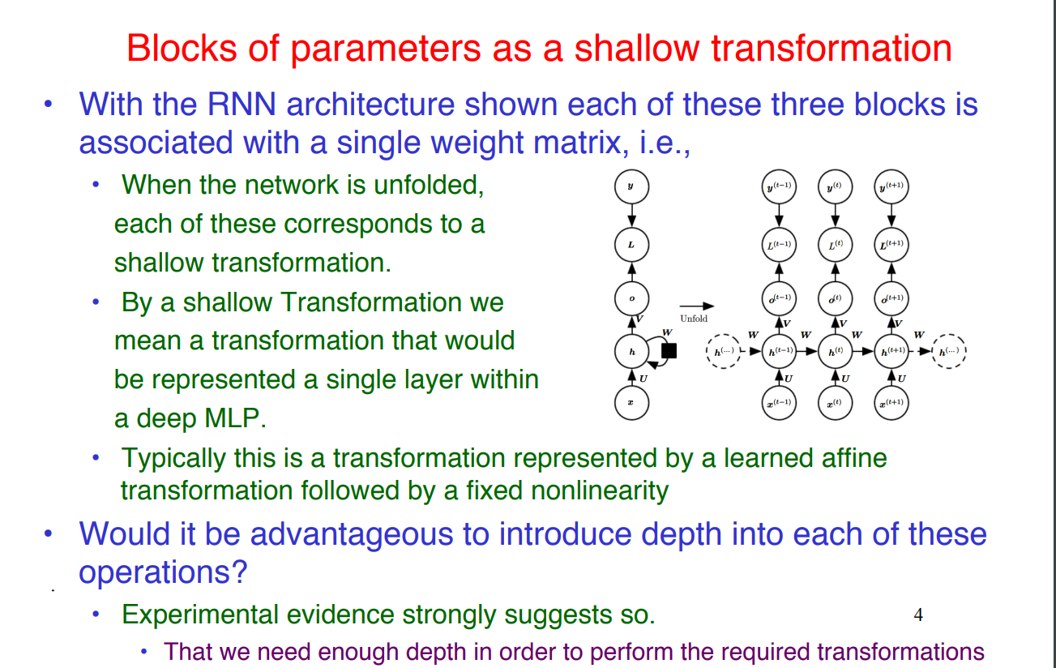

Slide 49
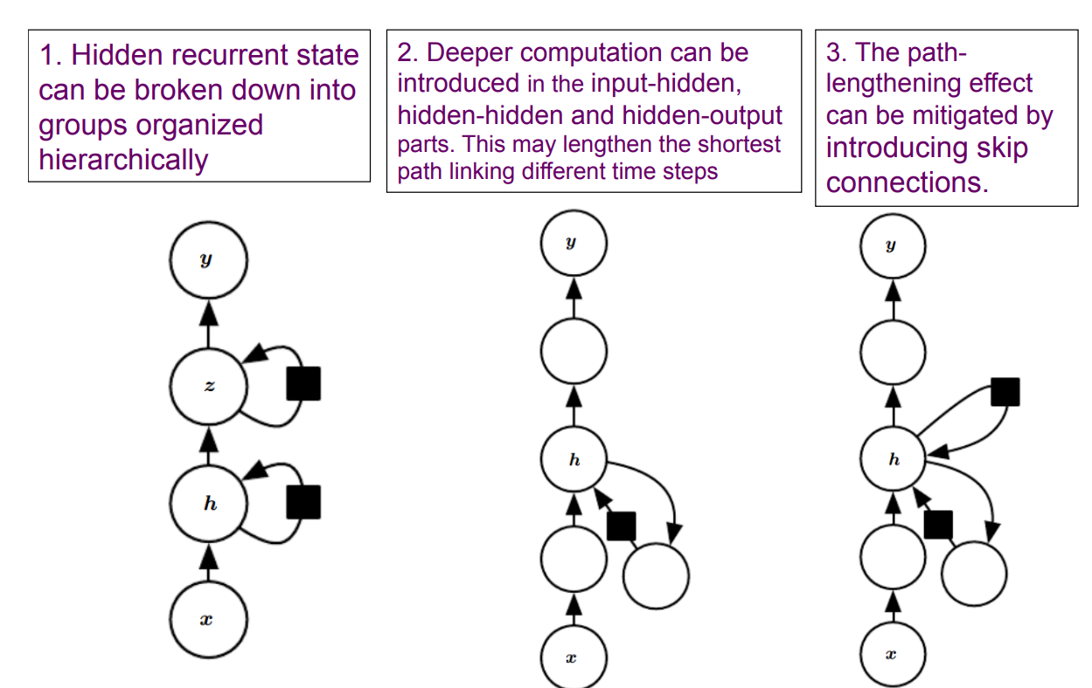
Ways of Making RNN Deep

Slide 50
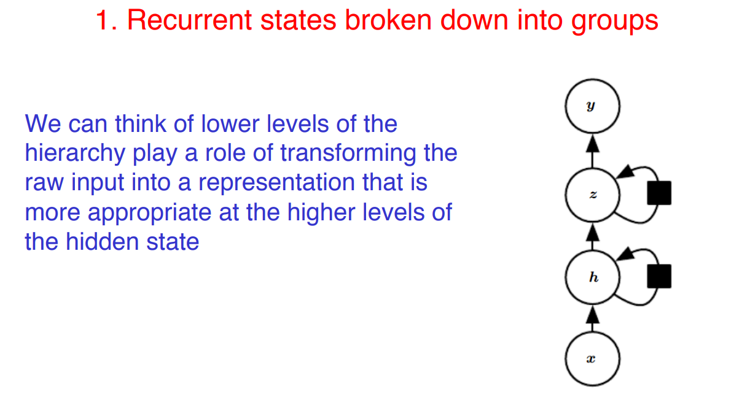

Slide 51
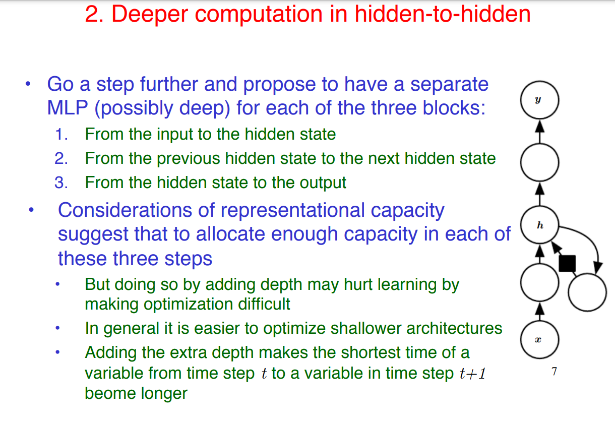

Slide 52
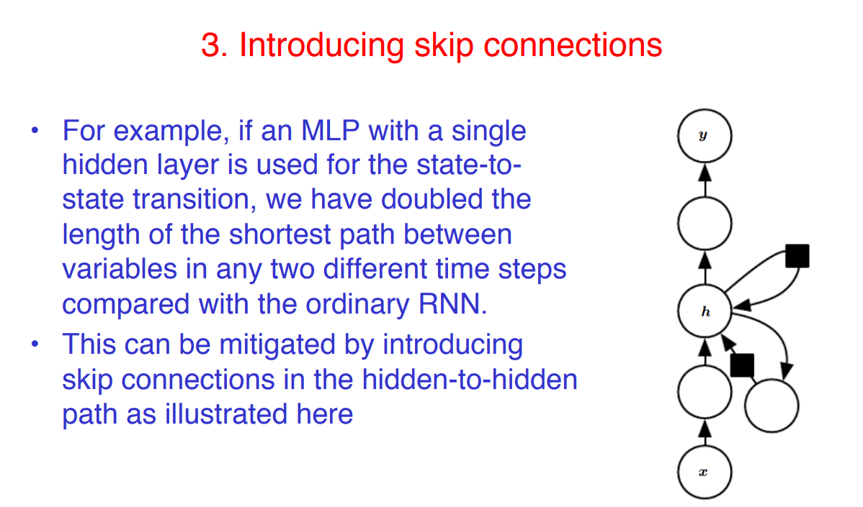

Slide 53
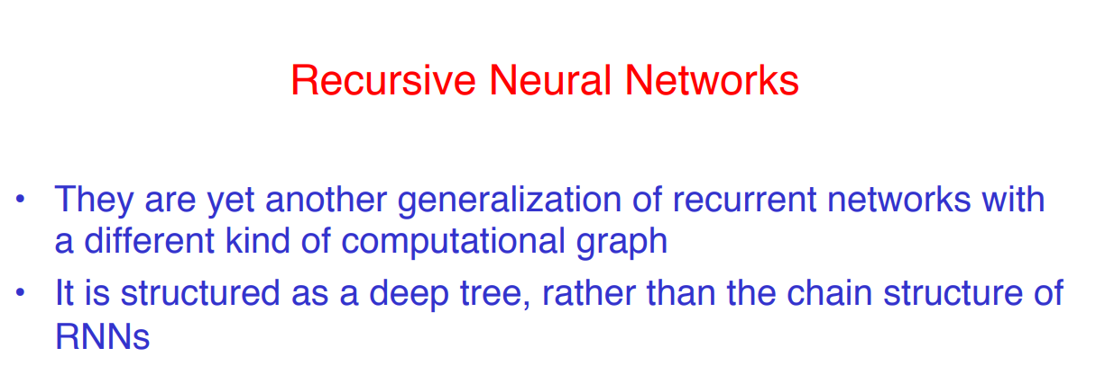
RECURSIVE NEURAL NETWORKS

Slide 54
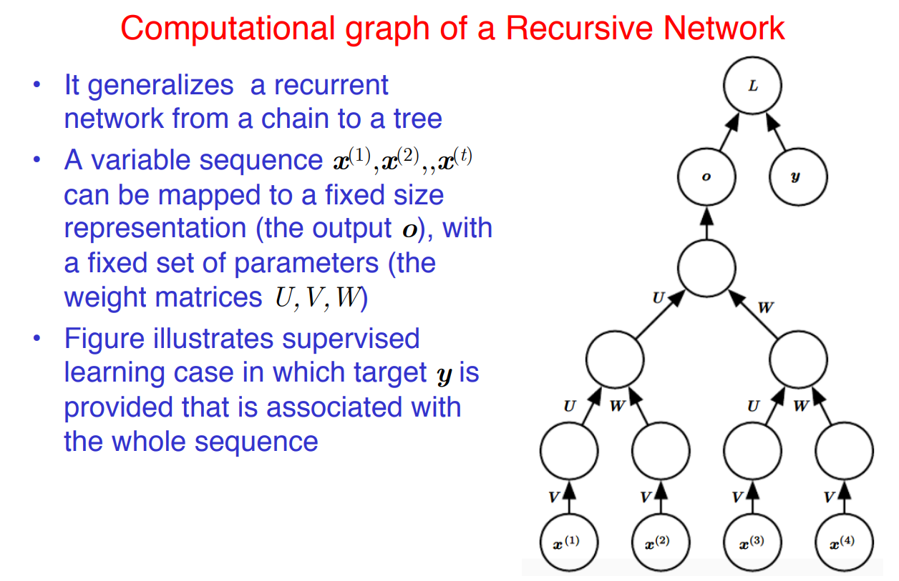

Slide 55
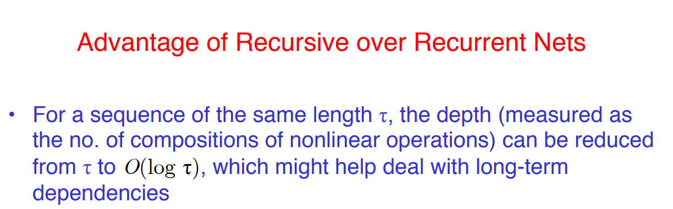

Slide 56
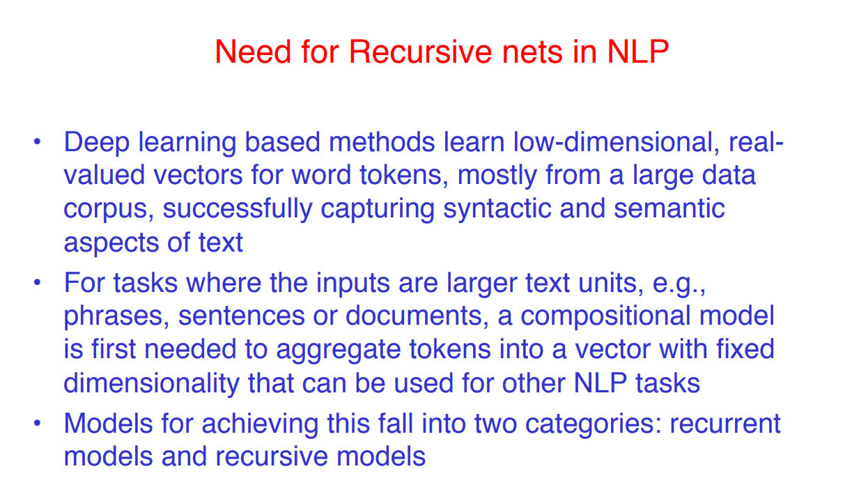

Slide 57
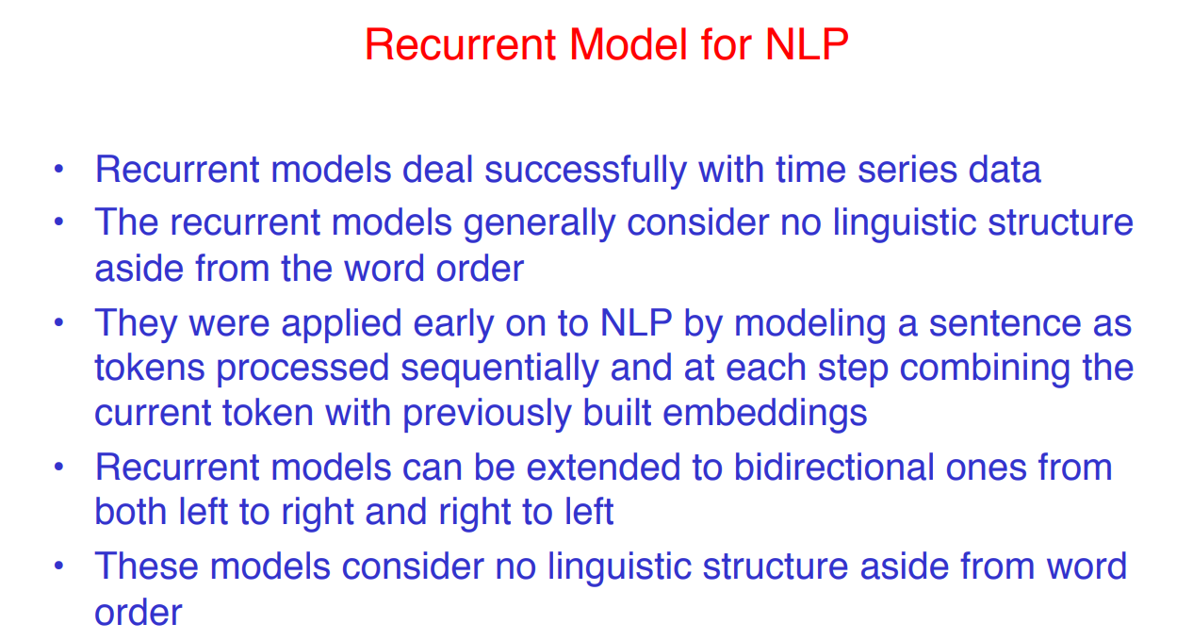

Slide 58
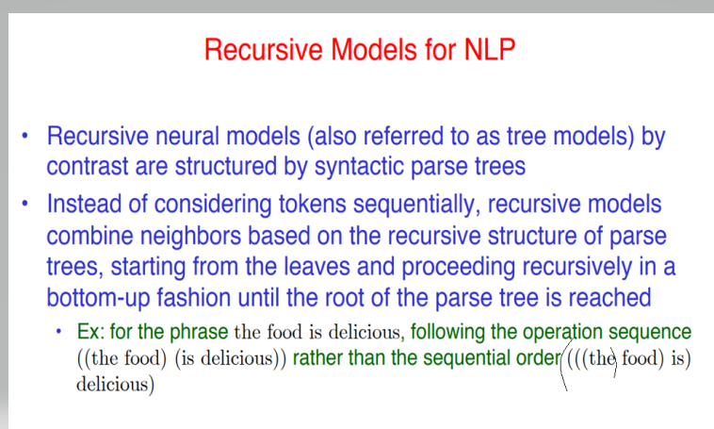

Slide 59
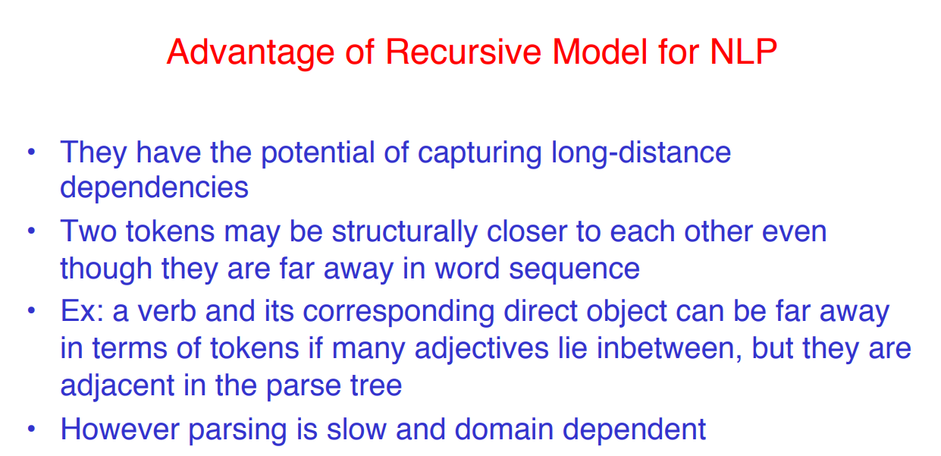

Slide 60
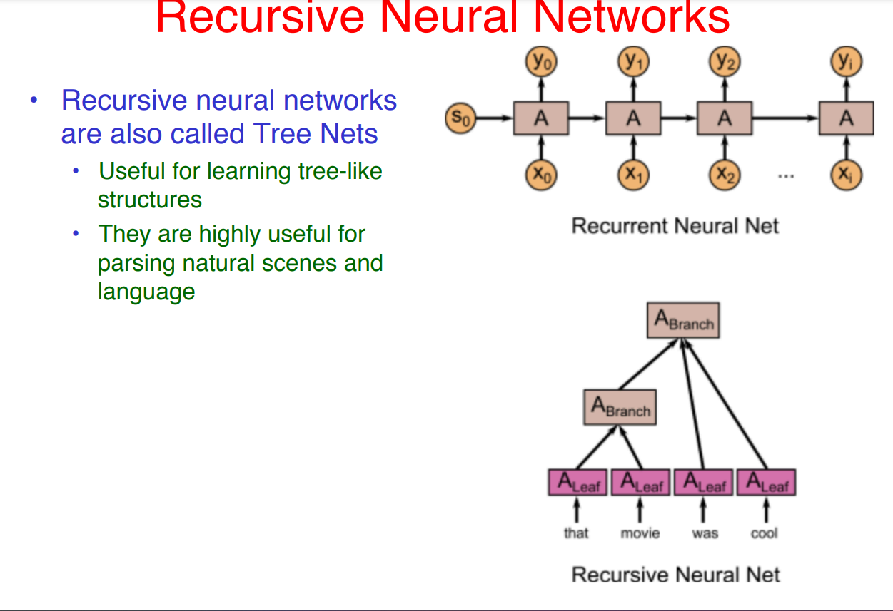

Slide 61
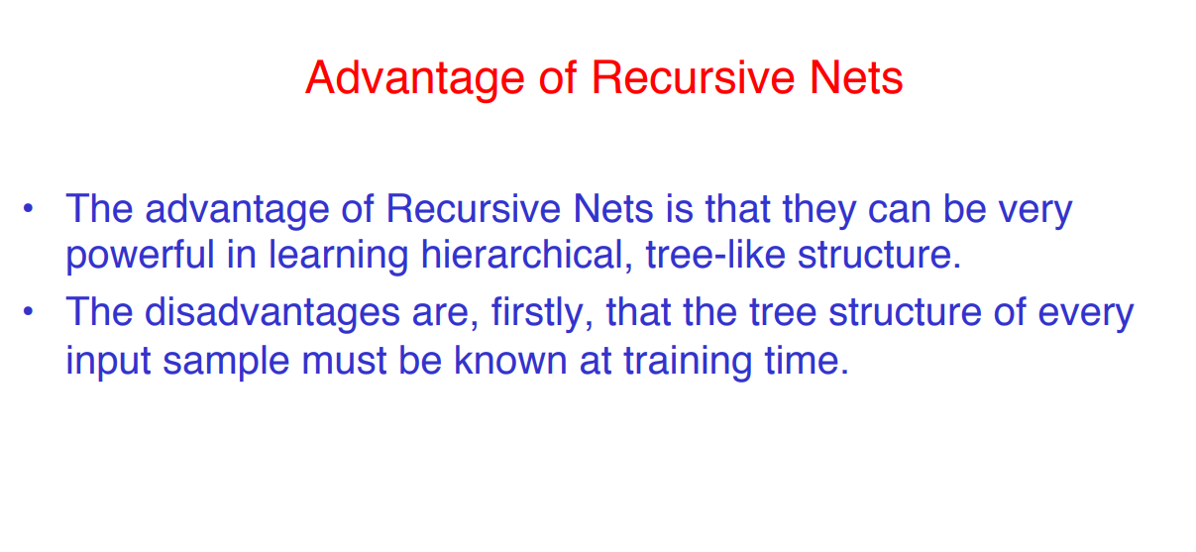

Slide 62
Challenges of Training Recurrent Network
Two Issues of Standard RNNs
1. Vanishing Gradient Problem
Recurrent Neural Networks enable you to model time-dependent and sequential data problems, like stock exchange prediction, artificial intelligence, and text generation. RNN is tough to train due to the gradient problem.
RNNs suffer from the matter of vanishing gradients. The gradients carry information utilized in the RNN, and when the gradient becomes too small, the parameter updates become insignificant. This makes the training of long data sequences difficult.

Slide 63
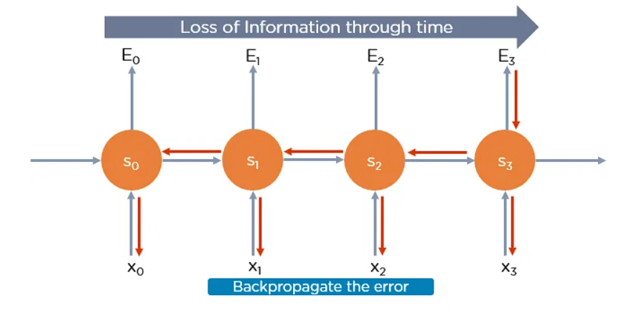

Slide 64
2. Exploding Gradient Problem
While training a neural network, if the slope tends to grow exponentially rather than decaying, this is often called an Exploding Gradient. This problem arises when large error gradients accumulate, leading to very large updates to the neural network model weights during the training process.
Long training time, poor performance, and bad accuracy are the key issues in gradient problems.

Slide 65
A gradient in the context of a neural network refers to the gradient of the loss function with respect to the weights of the network.
This gradient is calculated using backpropagation. The goal here is to find the optimal weight for each connection that would minimise the overall loss of the network.

Slide 66
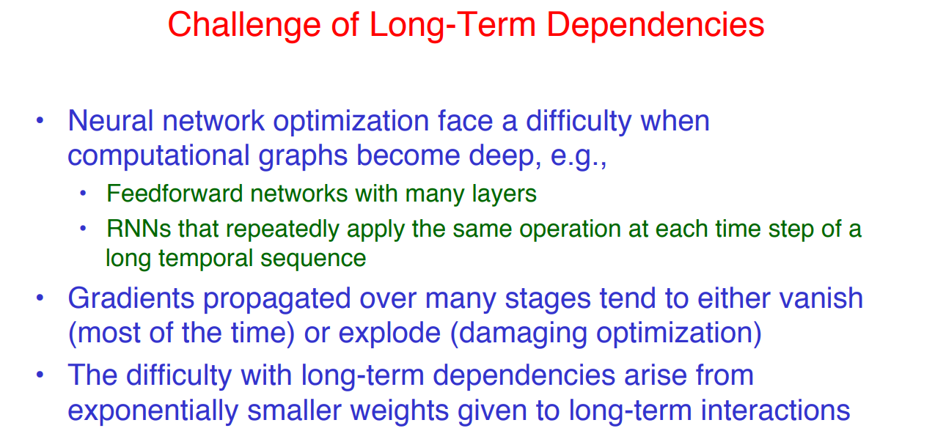

Slide 67
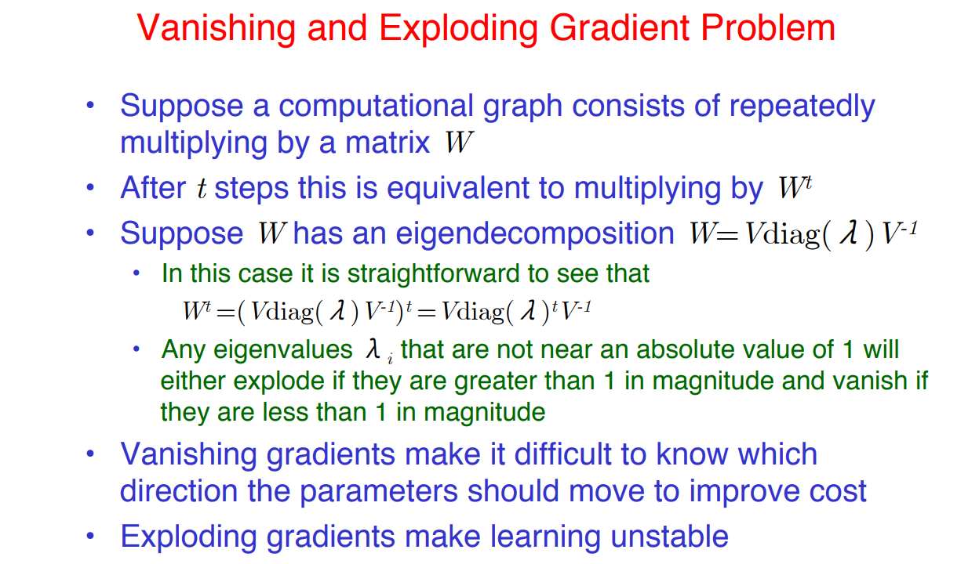

Slide 68
Recurrent neural networks are very hard to train because of the fact that the time-layered network is a very deep network, especially if the input sequence is long.
In other words,the depth of the temporal layering is input-dependent.
As in all deep networks, the loss function has highly varying sensitivities of the loss function (i.e., loss gradients) to different temporal layers.
Furthermore, even though the loss function has highly varying gradients to the variables in different layers, the same parameter matrices are shared by different temporal layers.
This combination of varying sensitivity and shared parameters in different layers can lead to some unusually unstable effects.

Slide 69
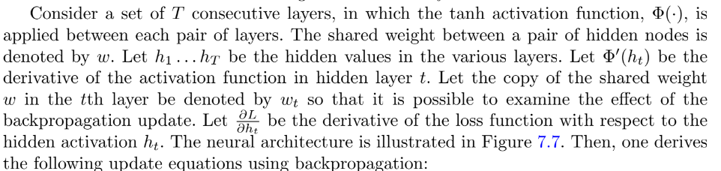
The primary challenge associated with a recurrent neural network is that of the vanishing and exploding gradient problems.

Slide 70
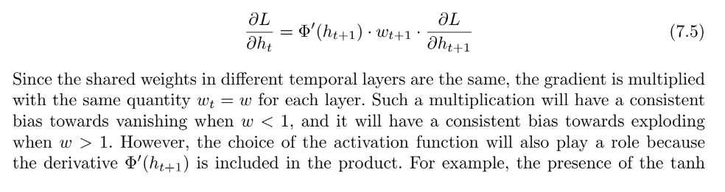

Slide 71
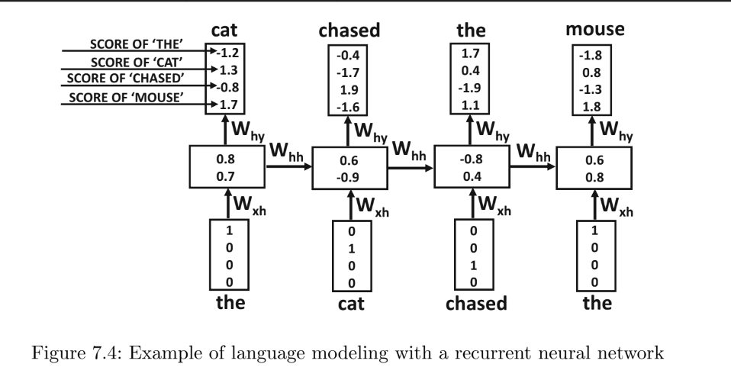
Language Modeling Example of RNN
Consider the sentence:
    The cat chased the mouse.
In this case, we have a lexicon of four words, which are {“the,”“cat,”“chased,”“mouse”}.

Slide 72
Ideally, we would like the probability of the next word to be predicted correctly from the probabilities of the previous words.
Each one-hot encoded input vector xt has length four, in which only one bit is 1 and the remaining bits are 0s.
The main flexibility here is in the dimensionality p of the hidden representation, which we set to 2 in this case.
As a result, the matrix Wxh will be a 2 × 4 matrix, so that it maps a one-hot encoded input vector into a hidden vector ‘ht’ vector of size 2.

Slide 73
Each column of Wxh corresponds to one of the four words, and one of these columns is copied by the expression Wxh xt. Note that this expression is added to Whh ht and then transformedwith the tanh function to produce the final expression.
The final output yt is defined by Why ht. Note that the matrices Whh and Why are of sizes 2 × 2 and 4 × 2, respectively.
In this case, the outputs are continuous values (not probabilities) in which larger values indicate greater likelihood of presence.
These continuous values are eventually converted to probabilities with the softmax function

Slide 74
The word “cat” is predicted in the first time-stamp with a value of 1.3, although this value seems to be (incorrectly) outstripped by “mouse” for which the corresponding value is 1.7.
However, the word “chased” seems to be predicted correctly at the next time-stamp.
As in all learning algorithms, one cannot hope to predict every value exactly, and such errors are more likely to be made in the early iterations of the backpropagation algorithm.

Slide 75
Generating Language Sample
The likelihoods of the tokens at the first time-stamp can be generated using the <START> token
as input.
Since the <START> token is also available in the training data, the model will typically select a word that often starts text segments.
Subsequently, the idea is to sample one of the tokens generated at each time-stamp (based on the predicted likelihood), and then use it as an input to the next time-stamp.
To improve the accuracy of the sequentially predicted token, one might use beam search.
By recursively applying this operation, one can generate an arbitrary sequence of text that reflects the particular training data at hand.
If the <END> token is predicted, it indicates the end of that particular segment of text.

Slide 76
GRU [Gated Recurrent Unit]
GRU (Gated Recurrent Unit) aims to solve the vanishing gradient problem which comes with a standard recurrent neural network.
GRU can also be considered as a variation on the LSTM because both are designed similarly and, in some cases, produce equally excellent results.
To solve the vanishing gradient problem of a standard RNN, GRU uses, so-called, update gate and reset gate.
Basically, these are two vectors which decide what information should be passed to the output.
The special thing about them is that they can be trained to keep information from long ago, without washing it through time or remove information which is irrelevant to the prediction.

Slide 77
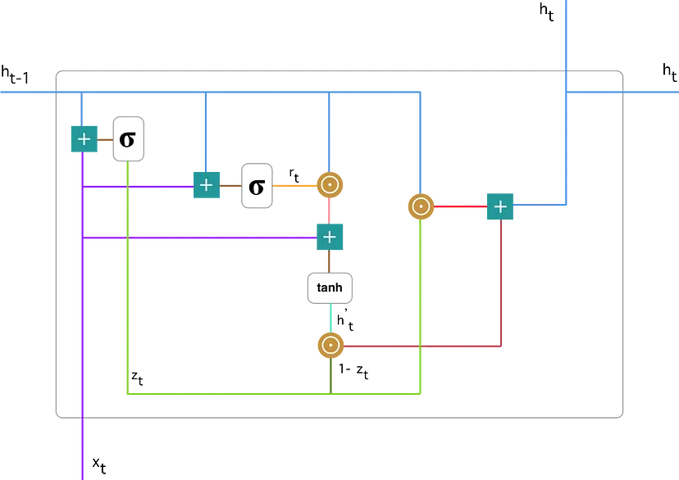

Slide 78
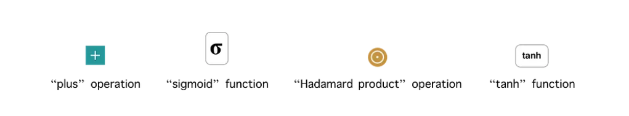

Slide 79
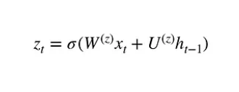
#1. Update gate
We start with calculating the update gate z_t for time step t using the formula:

Slide 80
When x_t is plugged into the network unit, it is multiplied by its own weight W(z). The same goes for h_(t-1) which holds the information for the previous t-1 units and is multiplied by its own weight U(z). Both results are added together and a sigmoid activation function is applied to squash the result between 0 and 1.

Slide 81
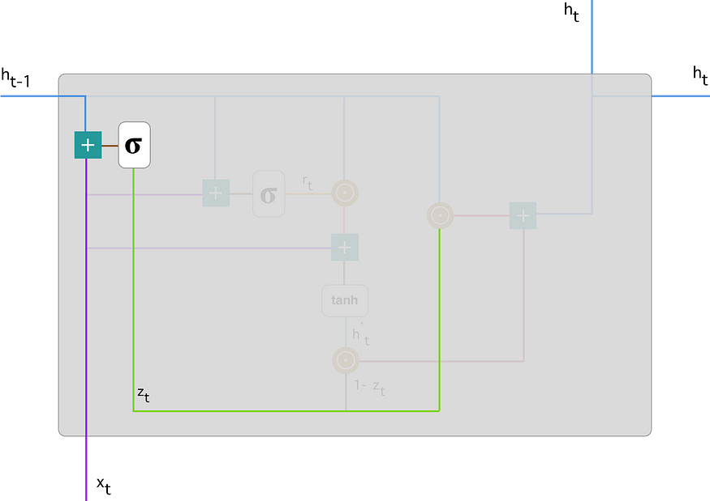

Slide 82
The update gate helps the model to determine how much of the past information (from previous time steps) needs to be passed along to the future.
That is really powerful because the model can decide to copy all the information from the past and eliminate the risk of vanishing gradient problem.

Slide 83

#2. Reset gate
Essentially, this gate is used from the model to decide how much of the past information to forget. To calculate it, we use:

Slide 84


Slide 85
As before, we plug in h_(t-1) — blue line and x_t — purple line, multiply them with their corresponding weights, sum the results and apply the sigmoid function.

Slide 86

#3. Current memory content
Let’s see how exactly the gates will affect the final output. First, we start with the usage of the reset gate. We introduce a new memory content which will use the reset gate to store the relevant information from the past. It is calculated as follows:

Slide 87


Slide 88


Slide 89
We do an element-wise multiplication of h_(t-1) — blue line and r_t — orange line and then sum the result — pink line with the input x_t — purple line. Finally, tanh is used to produce h’_t — bright green line.

Slide 90

#4. Final memory at current time step
As the last step, the network needs to calculate h_t — vector which holds information for the current unit and passes it down to the network. In order to do that the update gate is needed. It determines what to collect from the current memory content — h’_t and what from the previous steps — h_(t-1). That is done as follows:

Slide 91


Slide 92


Slide 93
Following through, you can see how z_t — green line is used to calculate 1-z_t which, combined with h’_t — bright green line, produces a result in the dark red line. z_t is also used with h_(t-1) — blue line in an element-wise multiplication. Finally, h_t — blue line is a result of the summation of the outputs corresponding to the bright and dark red lines.

Slide 94
GRUs are able to store and filter the information using their update and reset gates. That eliminates the vanishing gradient problem since the model is not washing out the new input every single time but keeps the relevant information and passes it down to the next time steps of the network. If carefully trained, they can perform extremely well even in complex scenarios.

Slide 95
BERT (Bidirectional Encoder Representations from Transformers)
BERT makes use of Transformer, an attention mechanism that learns contextual relations between words (or sub-words) in a text.
Transformer includes two separate mechanisms — an encoder that reads the text input and a decoder that produces a prediction for the task.
Since BERT’s goal is to generate a language model, only the encoder mechanism is necessary.

Slide 96
The Transformer encoder reads the entire sequence of words at once.
This characteristic allows the model to learn the context of a word based on all of its surroundings (left and right of the word).

Slide 97
BERT uses two training strategies:
Masked LM (MLM)
Before feeding word sequences into BERT, 15% of the words in each sequence are replaced with a [MASK] token. The model then attempts to predict the original value of the masked words, based on the context provided by the other, non-masked, words in the sequence.

Slide 98
In technical terms, the prediction of the output words requires:
Adding a classification layer on top of the encoder output.
Multiplying the output vectors by the embedding matrix, transforming them into the vocabulary dimension.
Calculating the probability of each word in the vocabulary with softmax.

Slide 99


Slide 100
The BERT loss function takes into consideration only the prediction of the masked values and ignores the prediction of the non-masked words.

Slide 101
Next Sentence Prediction (NSP)
In the BERT training process, the model receives pairs of sentences as input and learns to predict if the second sentence in the pair is the subsequent sentence in the original document.
During training, 50% of the inputs are a pair in which the second sentence is the subsequent sentence in the original document, while in the other 50% a random sentence from the corpus is chosen as the second sentence.

Slide 102
To help the model distinguish between the two sentences in training, the input is processed in the following way before entering the model:
A [CLS] token is inserted at the beginning of the first sentence and a [SEP] token is inserted at the end of each sentence.
A sentence embedding indicating Sentence A or Sentence B is added to each token.
A positional embedding is added to each token to indicate its position in the sequence.

Slide 103


Slide 104
To predict if the second sentence is indeed connected to the first, the following steps are performed:
The entire input sequence goes through the Transformer model.
The output of the [CLS] token is transformed into a 2×1 shaped vector, using a simple classification layer (learned matrices of weights and biases).
Calculating the probability of IsNextSequence with softmax.
When training the BERT model, Masked LM and Next Sentence Prediction are trained together, with the goal of minimizing the combined loss function of the two strategies.

Slide 105
How to use BERT (Fine-tuning)
Using BERT for a specific task is relatively straightforward:
BERT can be used for a wide variety of language tasks, while only adding a small layer to the core model:
Classification tasks such as sentiment analysis are done similarly to Next Sentence classification, by adding a classification layer on top of the Transformer output for the [CLS] token.
In Question Answering tasks (e.g. SQuAD v1.1), the software receives a question regarding a text sequence and is required to mark the answer in the sequence. Using BERT, a Q&A model can be trained by learning two extra vectors that mark the beginning and the end of the answer.
In Named Entity Recognition (NER), the software receives a text sequence and is required to mark the various types of entities (Person, Organization, Date, etc) that appear in the text.

